Slide 1

The 10x AI Engineering Approach
April 2026

Slide 2






Characteristics of 10x AI Professionals
10x AI professionals are force‑multipliers who combine deep technical capability with AI‑savviness and product‑thinking.
Architecture‑first mindset
AI‑driven problem‑solving
Zoom In and Zoom Out
They design and own system architecture, not just code; they think about scalability, observability, security, and AI‑agent‑driven SDLC as one coherent whole.
They use AI tools (Claude‑Code–style agents, Copilot, SDD toolkits) to accelerate design, coding, testing, and deployment, but remain the guardrails and validators, not the consumers.
Zoom in: Dive deep into complex technical problems and resolve issues others avoid.
Zoom out: Connect engineering work to customer value and organizational direction.
Systems‑thinking and cross‑functional collaboration
Fast‑learning and teaching
Security‑first Mindset
They bridge product, engineering, and data; they can operate as AI‑architects, AI‑practice leads, or "AI‑co‑pilots" to product teams.
They stay ahead of AI‑tooling evolution and actively mentor others; they turn AI‑best‑practices into reusable patterns, playbooks, and shared components.
They embed security, privacy, and compliance across AI-driven architecture, code generation, and SDLC, proactively managing risks while aligning with governance and regulations.

Slide 3



Our AI Delivery Framework — Where We Play to Win
We take architecture intent all the way to safe production - using specs, AI, and governance as one connected pipeline.
Architecture → Code
Code Generation
Code → Production
Our Architecture Framework
Defines a single, enforceable spec contract before modernization
Captures legacy behavior explicitly to establish a parity baseline
Maps clear service boundaries and ownership across teams
Removes hidden logic and undocumented dependencies early
Our Code Generation Framework
Generates POCs and production components from the approved spec
Enables Dev, QA, and Governance teams to work from one source of truth
Prevents functional drift during transformation and migration
Ensures zero deviation from legacy behavior where required
Our Code to Production Framework
Introduces multistage validation gates after early production issues
Enforces architecture boundaries and dependency isolation
Implements rollout safety, parity checks, and rollback readiness
Feeds production learnings back into the spec to prevent repeat failures

Slide 4


How do we select the right candidates
Hiring & selection for 10x AI Professionals
Given the premium nature of this role, hiring should be selective, contextual, and outcome‑oriented:
Profiles to target
Evaluation criteria
Talent‑sourcing
Software architects or principal engineers with AI‑tooling experience (Copilot, Claude‑Code–style flows, AI‑assisted testing, SDD, or agent‑based tooling). People who have already used AI in production‑level workflows, not just "POC" projects.
Ability to design and explain architectures that are AI‑augmented but human‑owned.
Evidence of AI‑driven productivity gains (e.g., SDD‑based flows, AI‑assisted code‑to‑prod pipelines, agent‑driven QA).
Mentoring and documentation skills (evidence of playbooks, patterns, or internal AI‑training).
Governance … add details here
Partner with AI‑academy‑style programs or AI‑leadership upskilling initiatives as a "pipeline" for ready‑made 10x‑ready profiles. Use AI‑co‑pilots in recruitment (e.g., AI‑assisted CV screening, skills‑mapping, and scenario‑based challenges).

Slide 5




10x AI Pods for Test Unit / Others
With Premium Offshore Pricing: 10–15k Per‑month
10x AI Pods are dedicated, outcome‑driven AI‑enabled engineering teams offered as a premium offshore service:
Composition
Engagement model
Each pod: 1–2 AI‑Architecture / AI‑Practice Leads + 3–5 AI‑Augmented Engineers.
Roles cover: AI‑driven design, SDD‑based spec‑to‑code, AI‑assisted testing, AI‑enabled CI/CD, and observability.
Embedded with client teams (e.g., TU) as AI‑CoE‑style pods for AI‑driven SDLC transformation.
Offered as managed services with KPIs around velocity, quality, test‑coverage, and AI‑tooling‑adoption‑rate.
Pricing
Scope
Premium offshore band of 10–15K per‑month per resource, reflecting the "10x" AI‑multiplier (higher skills, AI‑tooling, governance, and outcome‑focus).
Comparable to high‑end AI‑co‑pilot‑style agencies that charge 5–20K/month for AI‑driven workflow‑automation services.
Work on AI‑driven testing, SDD‑style development, AI‑assisted code‑generation, and AI‑enabled CI/CD pipelines tailored to the client's stack (e.g., Test Unit, cloud‑native, SaaS, etc.).

Slide 6



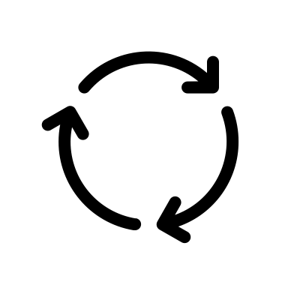


Outcomes
Faster time‑to‑value
Shorter feedback loops from requirement to production via AI‑driven specs, code‑generation, and test‑automation.
Higher quality and reliability
Repeatable, AI‑governed workflows reduce human‑error and increase test‑coverage, security‑checks, and auditability.
AI‑maturity uplift
Clients build internal AI‑CoE‑style capability; 10x AI Pods act as catalysts and templates for AI‑enabled engineering across the organization.
Economic advantage
Premium offshore pricing (10–15K/resource/month) still delivers 10x leverage versus traditional offshore when factoring in AI‑multiplier productivity, quality, and reduced rework.
ROI
Total cost includes Fixed Cost and Variable cost vis-a-vis Faster time to Value

Slide 7






Finding the 10x AI Engineer – Campus rollout
6 stages, covering technical, business and organizational fitment
Psychometric Test
HackerRank Test
Business Problem
Solution Presentation
HR / Org Fit
Offer & Rollout
30–60 min
120 min
Take-home
45 min
30 min
Final
Online personality assessment
Screens for role fit and work style
Problem solving, Python, SQL, prompt engineering Top 10% by percentile move forward
24 hour business problem; deck submission Any AI tools allowed; reviewed by leaders
F2f/Online round with the tech panel Defend approach, stack, priorities
Behaviour and attitude check Finalise offer, location, benefits
Offer extended
Onboarding kicks off
HOW IT COMES TOGETHER
Three teams, sequential handoff, two platforms
Talent Teams
Technical Panels
HR
Source candidates, manage pipeline, schedule screening invites
Review screening results, conduct deep-dive interviews on shortlisted candidates
Coordinate offers, run background checks, onboard successful candidates
TALENT PLATFORM
TEST PLATFORM
TALENT PLATFORM
Eightfold
HackerRank
Eightfold

Slide 8
Level 1: HackerRank test
Foundational, multi-disciplinary screen for Applied AI Engineering. Designed as a baseline filter, not a final gate.
120 min
4 sections
1 of N
Applied AI
Total duration
Python · PS · SQL · Prompt
Random draw per pool
Graduate Engineer role
Python
Problem Solving
SQL
Prompt Engineering
Advanced
Advanced
Intermediate
Basic → Intermediate
45 min · 1 of 3 · 100 pts
45 min · 1 of 5 · 100 pts
10–19 min · 1 of 6 · 75 pts
20 min · 1 of 6 · 50–75 pts
Power Coroutine — async fluency API Gateway — rate-limit & security logic Employee Bonus — data modeling
Async, system design, business logic
Algorithms & data-structure mastery
Realistic business schemas
Applied GenAI · NLP · RAG
Greedy / optimization Subset & combinatorial logic Graph reasoning, number theory
Joins & aggregations Window functions Tiered & conditional logic
Structured extraction & parsing Grounding in context LLM reasoning on real tasks
Power Coroutine - async fluency API Gateway - rate-limit & security logic Employee Bonus — data modeling
Greedy / optimization Subset & combinatorial logic Graph reasoning, number theory
Joins & aggregations Window functions Tiered & conditional logic
CORE SKILLS ASSESSED
QUESTION POOL DEPTH
NLP (Intermediate) • RAG (Basic) • Python (Intermediate) • Machine Learning
20 unique questions, randomized per candidate
Signal we're looking for
Covers the full Applied AI stack: production Python, algorithmic depth, business SQL, and applied GenAI / RAG. Anti-gaming controls in place: AI-monitored sections, randomized question pools, 120-minute cap. Reliable early-stage filter for high-potential graduates. Depth and behavioral fit belong in subsequent rounds.
Covers the full Applied AI stack: production Python, algorithmic depth, business SQL, and applied GenAI / RAG. Anti-gaming controls in place: AI-monitored sections, randomized question pools, 120-minute cap. Reliable early-stage filter for high-potential graduates. Depth and behavioral fit belong in subsequent rounds.

Slide 9
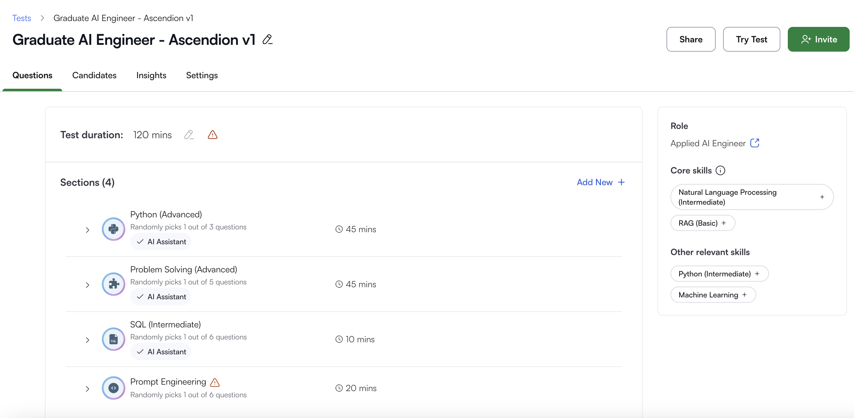
Level 1: Hackerrank test - Snapshot

Slide 10



Level-2: Business problem/System Design
STRUCTURE
COMPLEXITY
TIMING
OUTPUT
Technical + business
Reasonably complex,
24 hours
PPT
with enterprise constraints
solvable with modern AI tools
take-home
clarity over polish
WHAT WE EVALUATE
Approach
Problem breakdown
Solving under constraint
Framing of the problem and proposed solution direction
Decomposition into components, dependencies, sequencing
Trade-offs against regulatory, privacy, and data limits
EXAMPLE PROBLEM STATEMENTS
1. EU CORPORATE BANK
2. UK PAYMENTS
Design a contextual user memory for a financial co-pilot for a regulated corporate bank in EU.
Put together an end-to-end merchant onboarding (e-KYC) for a UK payment aggregator to reduce time from 4–5 days to 1–2 hours, with relevant human checks.
Signal we're looking for
Clarity of thought in breaking the problem down. Polish is not scored — structure, trade-offs, and constraint-handling are.

Slide 11


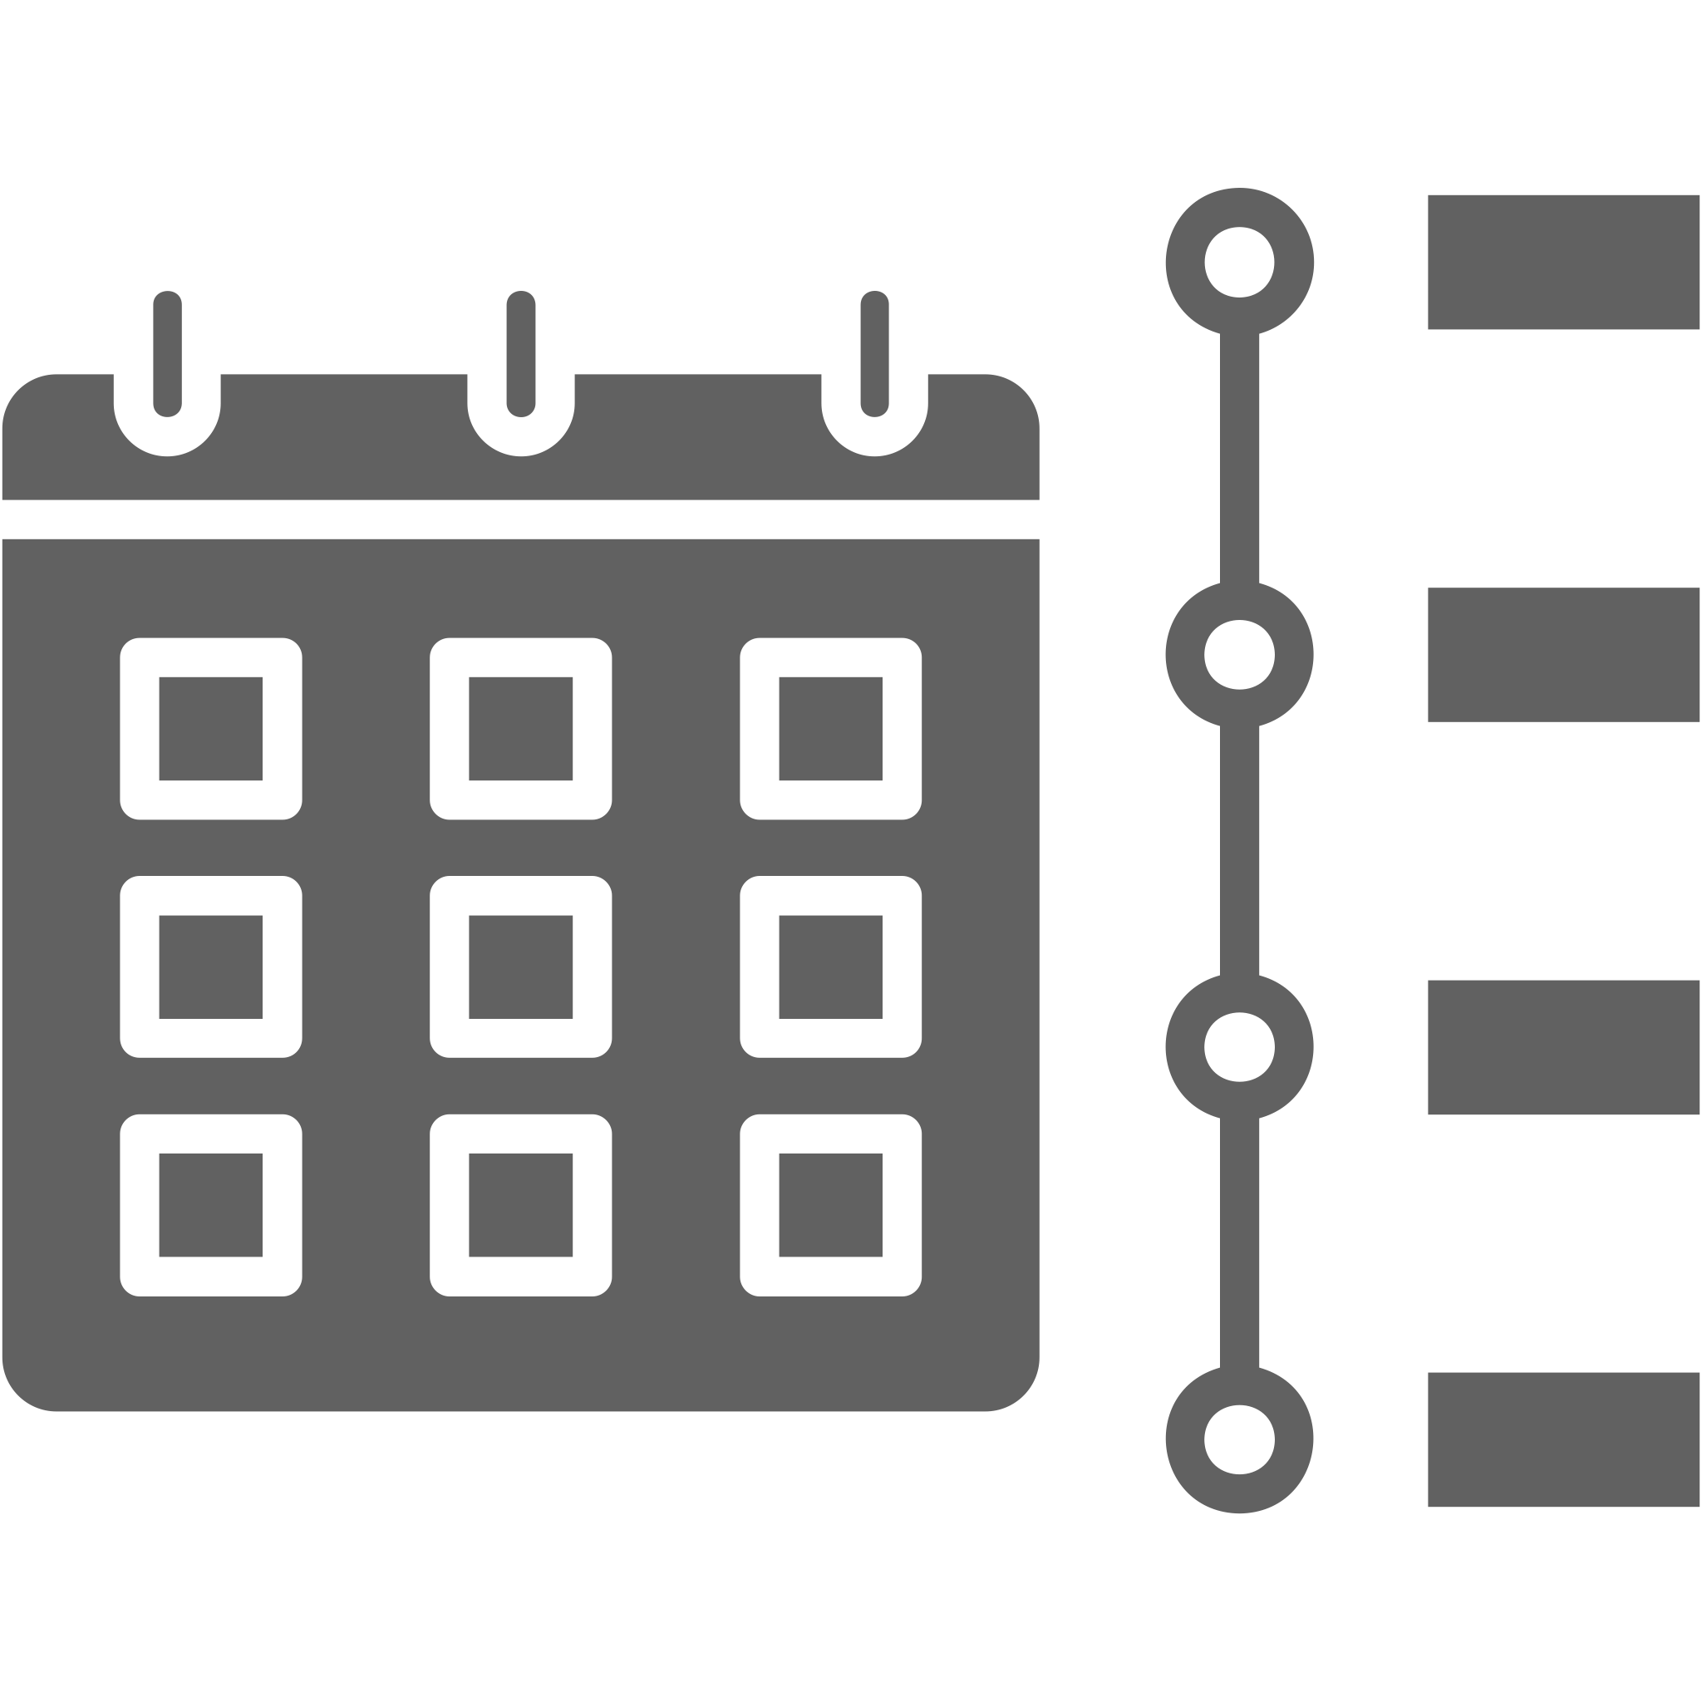
Level-3: Solution Presentation/Technical Panel interview
FORMAT
PANEL
TIMING
FOCUS
Hackathon-style
Technical panel
45 minutes
Decision-making
candidate presents own solution
live Q&A and probing
f2f or online
under real constraints
WHAT WE EVALUATE
Judgement & taste
What NOT to build
Planning & sequencing
Quality of choices made, sense for what good looks like
Scope discipline; recognising over-engineering and waste
How work is structured, prioritised, de-risked
SAMPLE PANEL Q&A
1. EU CORPORATE BANK
2. UK PAYMENTS
Where does the memory live, and who can read it under GDPR?
What did you deliberately leave out of v1, and why?
How do you handle a relationship manager covering 20 clients without leakage?
• Which checks stay automated and which need a human in the loop? • What breaks first when you compress 4 days into 90 minutes? • How do you defend the 1-2 hour SLA to FCA / compliance?
Signal we're looking for
Filters out token-maxxers on Pro/Max plans who lean on AI for everything. We want operators with judgement, taste, and a point of view on what to leave out.

Slide 12



Final level assessment: HR interview + Offer rollout
FORMAT
TIMING
PANEL
OUTCOME
Hackathon-style
45 minutes
HR + hiring manager
Offer rollout
candidate presents own solution
f2f or online
values, motivation, growth
role, location, benefits
WHAT WE EVALUATE
Behavior
Attitude
Personality fit
How they handled past conflict, ambiguity, and ownership calls
Curiosity, resilience, response to feedback and being challenged
Values alignment, collaboration style, long-term motivation
OFFER ROLLOUT
01
02
03
04
Finalise role
Location
Compensation
Offer letter
Level, scope, reporting line
Base office, hybrid, relocation
Salary, equity, signing bonus, benefits
Issue, negotiate, sign, start date
ONBOARDING & TRAINING — TA / HR TO COMPLETE
Week 1 — Onboarding
Weeks 2–4 — Ramp-up
Months 2–3 — Training plan
Tooling, access, team intros, buddy assignment
Codebase walkthrough, first low-risk ticket, shadowing
Domain modules, certifications, first owned deliverable
[ to be added by TA / HR ]
[ to be added by TA / HR ]
[ to be added by TA / HR ]
Goal: a confident yes from both sides — clear offer, clear ramp, clear first 90 days.

Slide 13
Operational mechanics — who does what
Operational aspects, from TA, Circle, HR to vendors
RUN THE FUNNEL
DEFINE THE BAR
ASSESS CAPABILITY
CLOSE THE LOOP
Talent Acquisition
Business Leaders
Technical Panel
HR
Source via Eightfold AI Schedule Hacker Rank Level 1 Coordinate panels and logistics Own candidate comms and offer rollout
Set role profile and pod requirements Approve scorecards and hiring criteria
Final go/no-go on offers Sponsor onboarding into the pod
Lead Level 2 technical deep-dives Evaluate coding, system design, AI fluency Calibrate scoring across panels Submit structured feedback within 24h
Run HR conversation and culture fit Manage compensation and offer structure Handle background checks and compliance Drive Day-1 readiness and 90-day ramp
PLATFORMS
TALENT INTELLIGENCE
TECHNICAL ASSESSMENT
Eightfold
HackerRank
AI-driven sourcing and candidate matching across the funnel — used by TA to surface high-fit profiles and pre-screen at scale.
AI-driven sourcing and candidate matching across the funnel — used by TA to surface high-fit profiles and pre-screen at scale.
Level 1 coding and AI-fluency tests — auto-graded, calibrated against the 10x bar, feeds shortlist into the technical panel.
OPERATING PRINCIPLE
One funnel, four owners, two platforms. TA runs throughput, leaders set the bar, the panel proves the skill, HR closes the offer.

Slide 14


The 10x AI Engineering Approach

Slide 15


